Slide 1
Graduate Student Association
General Body Meeting wednesday septeber 25th, 2013
12pm wbs utmost bound

Slide 2
Agenda
Minutes from September General Body Meeting
Treasurer’s Report
Campus Groups
Upcoming Events / Announcements
October Social Event
Happy Healthy Halloween
October Town Hall Meeting
November Community Service
Community Day
GSA T-Shirt
GSA Photo Showcase
February Social
Research Week (March)
Thanksgiving Meeting
Questions, Comments, Concerns
Adjourn

Slide 3
Treasurer’s Report
GSA Initial Amount | 3912.51
Metro Parks Nashville (Cenntineal Park) | 30
Grill Rental | 84
Icecream Social | 162.5
Sams Club | 254.43
Jim N Nicks | 258.5
Stephanie water & Ice | 16.02
Jessica burger needs | 32.01
1st General Body Meeting Pizza | 218.34
Jessica Sutton Softball shirts | 121.2
2nd General Body Meeting Honey baked ham | 420
3rd General body Meeting | 385
Total | 1930.51
Missing Money deposit | +2000
Fall Registration | +10,500
Working Budget | 14430.51

Slide 4
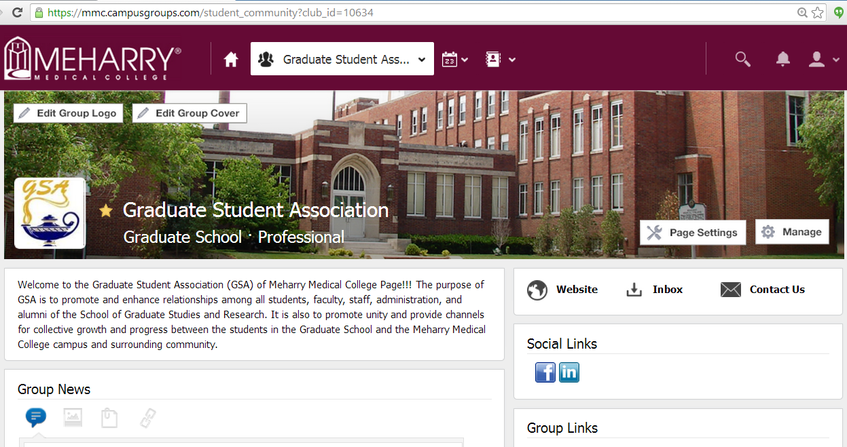
Campus Groups- GSA Page mmc.campusgroups.com
P.S. We have a facebook page! (Graduate Student Association GSA of Meharry Medical College

Slide 5
Thank You!!

Slide 6
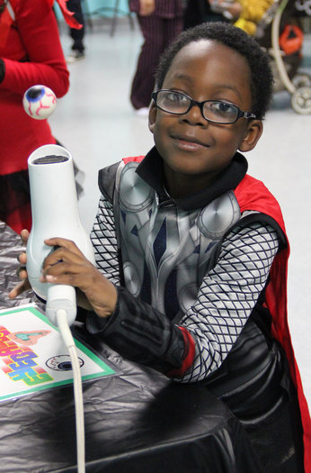
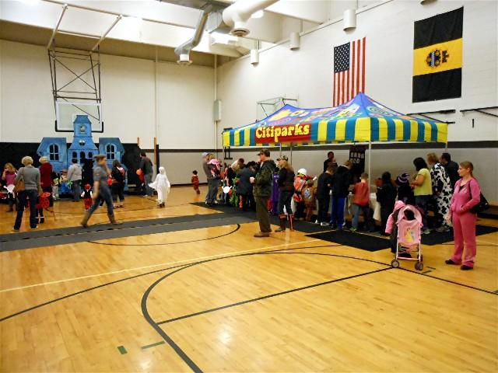
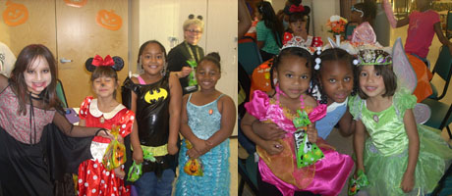
Happy Healthy Halloween
Thursday October 31st at 4:30pm in Ross Fitness Center
Volunteers must arrive by 2:30pm!!!
Table theme is “Mad Scientists!”
Will be making “boo bubbles” and “slime” as well as passing out candy.
For questions email JSutton11

Slide 7
GSA T-Shirt
Thank you to all who voted!
Low Sales
Shirts on sale until Monday
Paypal requests will be sent out on Monday November 4th
Shirts will be ordered on Tuesday November 5th
Shirts will cost $15

Slide 8
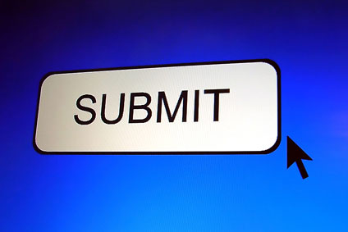
Call for GSA Photos!!!!
Pictures needed for display case in Atrium
20 – 4X6 Photos
White Coat Ceremony
Convocation
2013 Graduation
GSA Events
Meharry Email: Stephanie Pulliam (spulliam09)

Slide 9
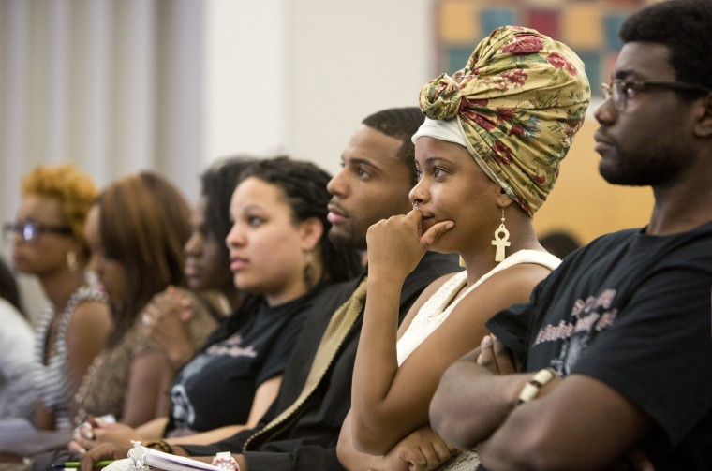
Town Hall Meeting
Thank you to everyone who came out and everyone who submitted a question
Responses were emailed out to students and are available for viewing on Campus Groups.

Slide 10
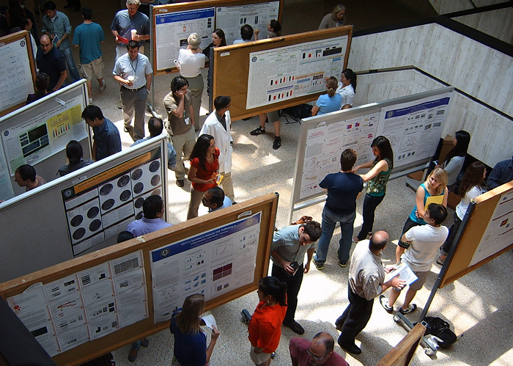
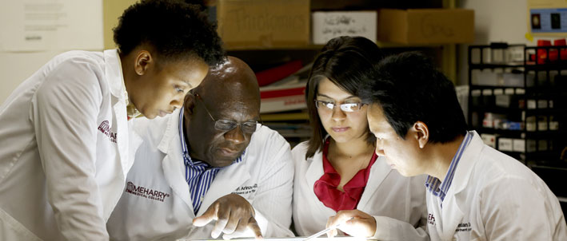
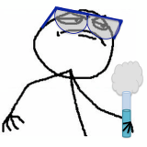
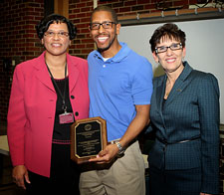
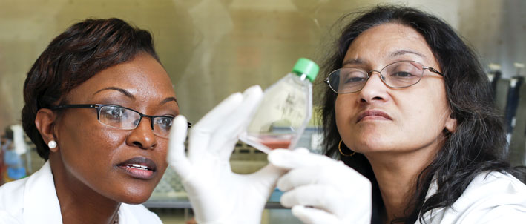
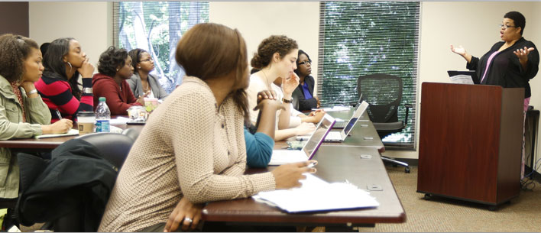
Research Week Committee
Sign up is now OPEN!
Contact Joseph Smith (JTSMITH11@email.mmc.edu)

Slide 11
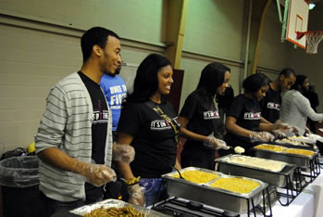
November Service Event
Nashville Rescue Mission
Women’s Campus (requires background check)
Nov 9 @ 6am-8am (~8 volunteers)
Men’s Campus
Nov 2 @ 4:30am-7am (~13 volunteers)
Nov 10 @ 10:30am-1am (~6 volunteers)
Nov 17 @ 4:30am-7am (~14 volunteers)
Other Options are during school hours
Holy Name 1st & 3rd Friday Food giveaway 12-3pm
Community Care Fellowship Lunch T,Th,F 11:30a-12:30p
Waiting on Response: Salvation Army Soup Wagon

Slide 12
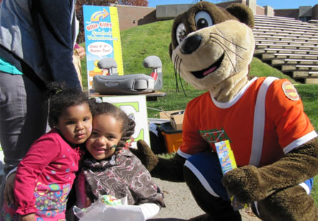
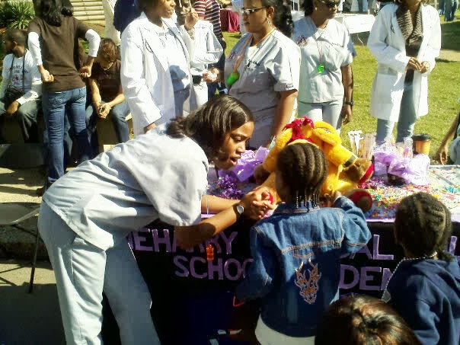
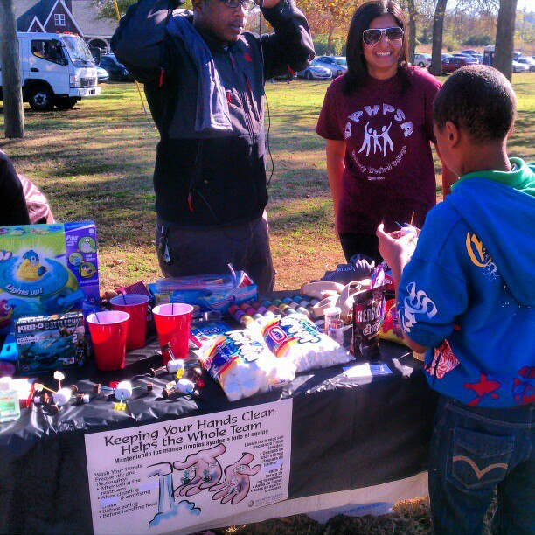
Community Day Committee
Contact Chelsie Swepson (CSwepson09@email.mmc.edu)
November 2nd

Slide 13
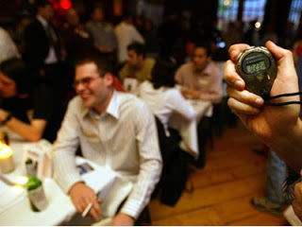
February Social Anyone???
Professional “Networking” Event
Invite professional and graduate students from neighboring schools:
Belmont
Fisk
Lipscomb
Nashville School of Law
TSU
Trevecca Nazarene
Vanderbilt

Slide 14
WEDNESDAY NOVEMBER ___TH!!!!!!!!!!!!
GSA will provide the MEAT ONLY!
A SIGN UP SHEET WILL BE EMAILED OUT TO STUDENTS AND WILL CLOSE ON MONDAY NOVEMBER ____
$50 Gift card will go to the winner of the best dish!
Voting will take place at the meeting and the winner will be announced at the end

Slide 15
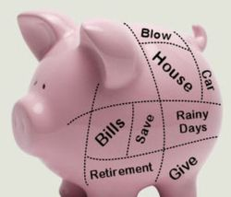
Required Financial Wellness Workshop
Mandatory 2nd session workshops begin NEXT WEEK at 5:30pm in LRC
Tuesday, Wednesday, or Friday!

Slide 16
Questions, Comments, Concerns?

Slide 17
ADJOURN

