Slide 1
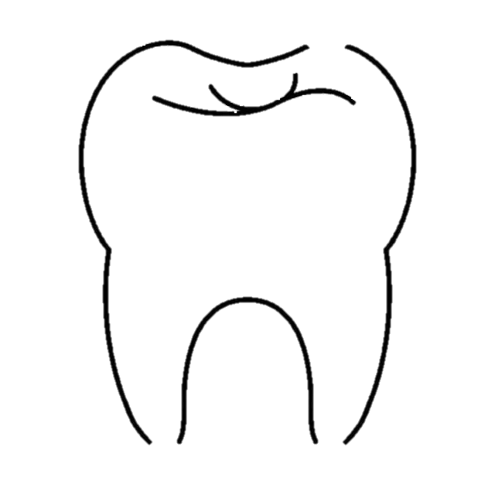
Launching Your Dental Career
DENTAL DREAMS
Lunch & Learn
Presented by Amadi Forbes
Dentist Recruiter & University Partner
Notes:
For those of you who don’t know me, my name is Amadi Forbes and I’m a recruiter with Dental Dreams.
My job is to travel around the East Coast schools and meet all of you amazing dental students.
Goal today is to give you insight to the job market and help prepare you for interviews as you start your career.
I’ll share information both about finding the right path after dental school, as well as specifically Dental Dreams as a company.
No matter if your path is residency or coming to work for a DSO, hopefully you’ll all learn something new.
Hi Everyone, my name is Aldo Diaz. Thank you so much

Slide 2
🦷 The Current Dental Job Market
📄 Resume Best Practices
🎤 Interview Success
💰 Understanding Compensation & Contracts
❓Questions Every Dentist Should Ask
🏥 What Makes Dental Dreams Different
🎁 Amazon Gift Card Giveaway
Today’s Agenda
Notes:
For those of you who don’t know me, my name is Amadi Forbes and I’m a recruiter with Dental Dreams.
My job is to travel around the East Coast schools and meet all of you amazing dental students.
Goal today is to give you insight to the job market and help prepare you for interviews as you start your career.
I’ll share information both about finding the right path after dental school, as well as specifically Dental Dreams as a company.
No matter if your path is residency or coming to work for a DSO, hopefully you’ll all learn something new today to take with you along your journey.

Slide 3
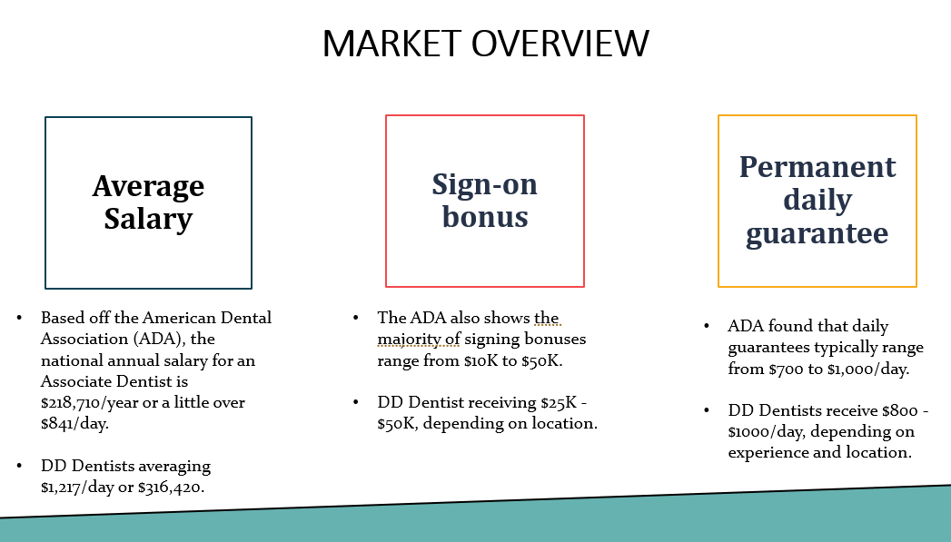
Market Overview
Notes:
For those of you who don’t know me, my name is Amadi Forbes and I’m a recruiter with Dental Dreams.
My job is to travel around the East Coast schools and meet all of you amazing dental students.
Goal today is to give you insight to the job market and help prepare you for interviews as you start your career.
I’ll share information both about finding the right path after dental school, as well as specifically Dental Dreams as a company.
No matter if your path is residency or coming to work for a DSO, hopefully you’ll all learn something new today to take with you along your journey.

Slide 4
General Dentists Resume
DO:
Showcase Clinical Experience: Clearly list procedures you’ve performed, clinical rotations, and any specialties you've explored (Ex: endo, pediatrics).
Quantify Your Experience: Ex: “Performed 100+ cleanings and restorations during externship.”
Highlight Certifications: Include (pending) state licenses, passed boards, CPR certification, and any conferences attended.
Show Leadership & Volunteerism: Student orgs, mission trips, or tutoring.
Notes:
Volunteer roles show initiative and character.

Slide 5
Resume Tips
DO:
Utilize templates
Ex: “Modern Professional Resume”
Highlight languages spoken/achivements
Save as PDF
  Ex: AmadiForbesCV.pdf
DON’T:
Forget your contact
information at top of page
Highlight outdated experience
Go longer than 1-2 pages
Notes:
Only include professional pictures.
Always have a second set of eyes review your resume. Utilize campus resources.
Make sure information is visually easy to digest. Google Modern Professional Resume templates. Include color if desired.
Bilingual skills are a big plus in diverse communities.
Ideally do not include experience prior to undergrad. Include unrelated jobs unless they show key skills (e.g., customer service).
Save

Slide 6
Interview Success
PREPARE:
Practice common interview questions
Research the company and leadership
Connect on LinkedIn
Present yourself in a professional way (environment and attire)
Understand the company’s patient base, services offered, and mission.
Notes:
Every interview will be different, so it is important to prepare for a variety of situations.
It is important to understanding the practice's values, services, and patient demographics.
For Dental Dreams, you could say: “I’m passionate about serving underserved communities, so your mission really resonates with me.”
Professional attire or scrubs, Quiet setting, Good posture and eye contact
Tell me about yourself
Why do you want to work here?
What are your greatest strengths and weaknesses?

Slide 7
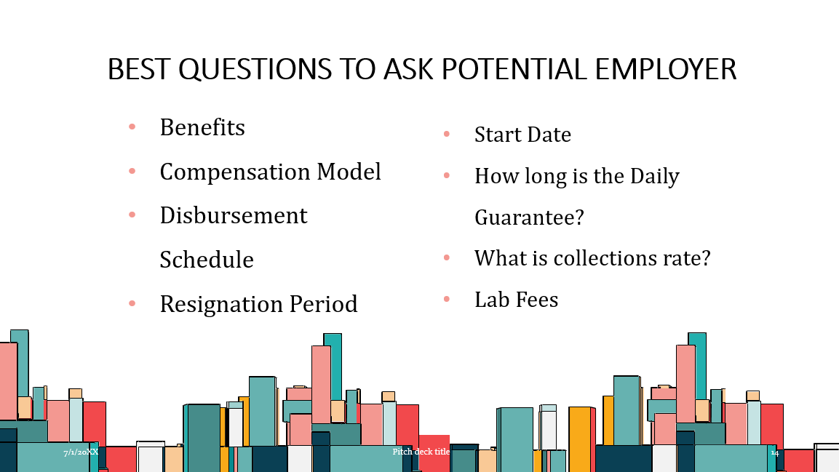
Interview Tips
ASK QUESTIONS:
Identify keywords in the job description to tailor your questions.
Who is your ideal candidate?
What kind of CE and mentorship can I expect as a new graduate?
How do you handle complex procedures or referrals?
Notes:
Ideal: someone who shows confidence and adaptability. We want someone with a strong foundation that is willing to learn and grow with our company.
Is resignation Process: Verbal, Written, Payments
Timeframe:30/60/90 days
Scheduling

Slide 8
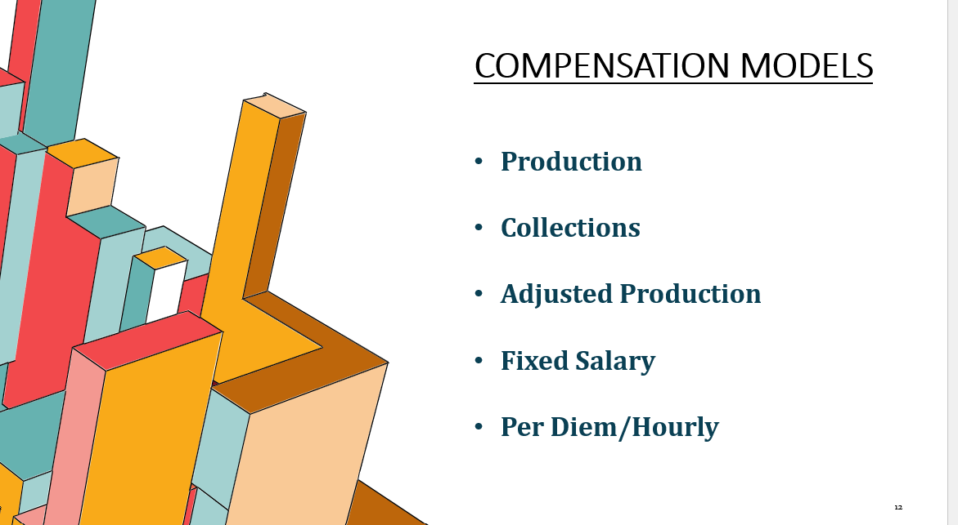
Market Overview
Notes:
Adjusted Production
Paid on production after write-offs (insurance discounts, PPO adjustments, etc.).
More accurately reflects the revenue the practice expects to receive.
One of the most common compensation models among large DSOs.
Collections
Paid only after the practice actually collects payment from insurance companies or patients.
Income can be delayed by insurance processing, claim denials, or patient payment plans.
Less predictable and can fluctuate even when production is high.

Slide 9

Competitive Compensation
Average compensation of full-time dentists in their first year at Dental Dreams:
$290,000+ annually
Sign-on bonus up to $50,000
Permanent daily guarantee
30-35% of production
Notes:
Compensation is based on office location and demand
One year contract tied to sign on bonus
No claw back and daily guarantee never expires
No cap on production pay
Production (Gross Production) vs Adjusted Production (Net Production). The biggest difference is the schedule in which you get paid. A lot of times on collection, you might get paid once a month because there is a big discrepancy between what is billed vs what is collected.
You do a crown that’s priced at $1,200 on the office’s fee schedule.
Your production for that crown = $1,200, even if the patient’s insurance only allows $900 and that’s all we collect.
Gross production pay: Tends to look better on paper but is rarer — and can be more generous for dentists, especially in high-insurance practices.
Adjusted production pay: More common and reflects real revenue the office expects to collect, so it’s less risky for the practice
As we settle bills and claims, if there is a discrepancy and there is an amount that is not obtained, you will see that amount deducted from future pay checks. the reason we can do that is because the amount is so small. Our collection rate is about 98%
We collect at 98%

Slide 10
Compensation Equation
(total of bi-weekly Production X .30) – (lab fees X .30) = Compensation
OR
$700.00 per 8 hour work day
(Calculated on a bi-weekly basis)
Notes:
Dentist’s compensation shall be the greater compensation of the following:

Slide 11
Why Choose Dental Dreams?
Autonomy from Day One: You control your treatment plans, supplies, and schedule.
Full, Consistent Patient Load: 10-18 patients/day in fully digital, paperless offices.
Supportive Learning Environment: Work with 2–5 associates per office in a team-based setting.

Slide 12
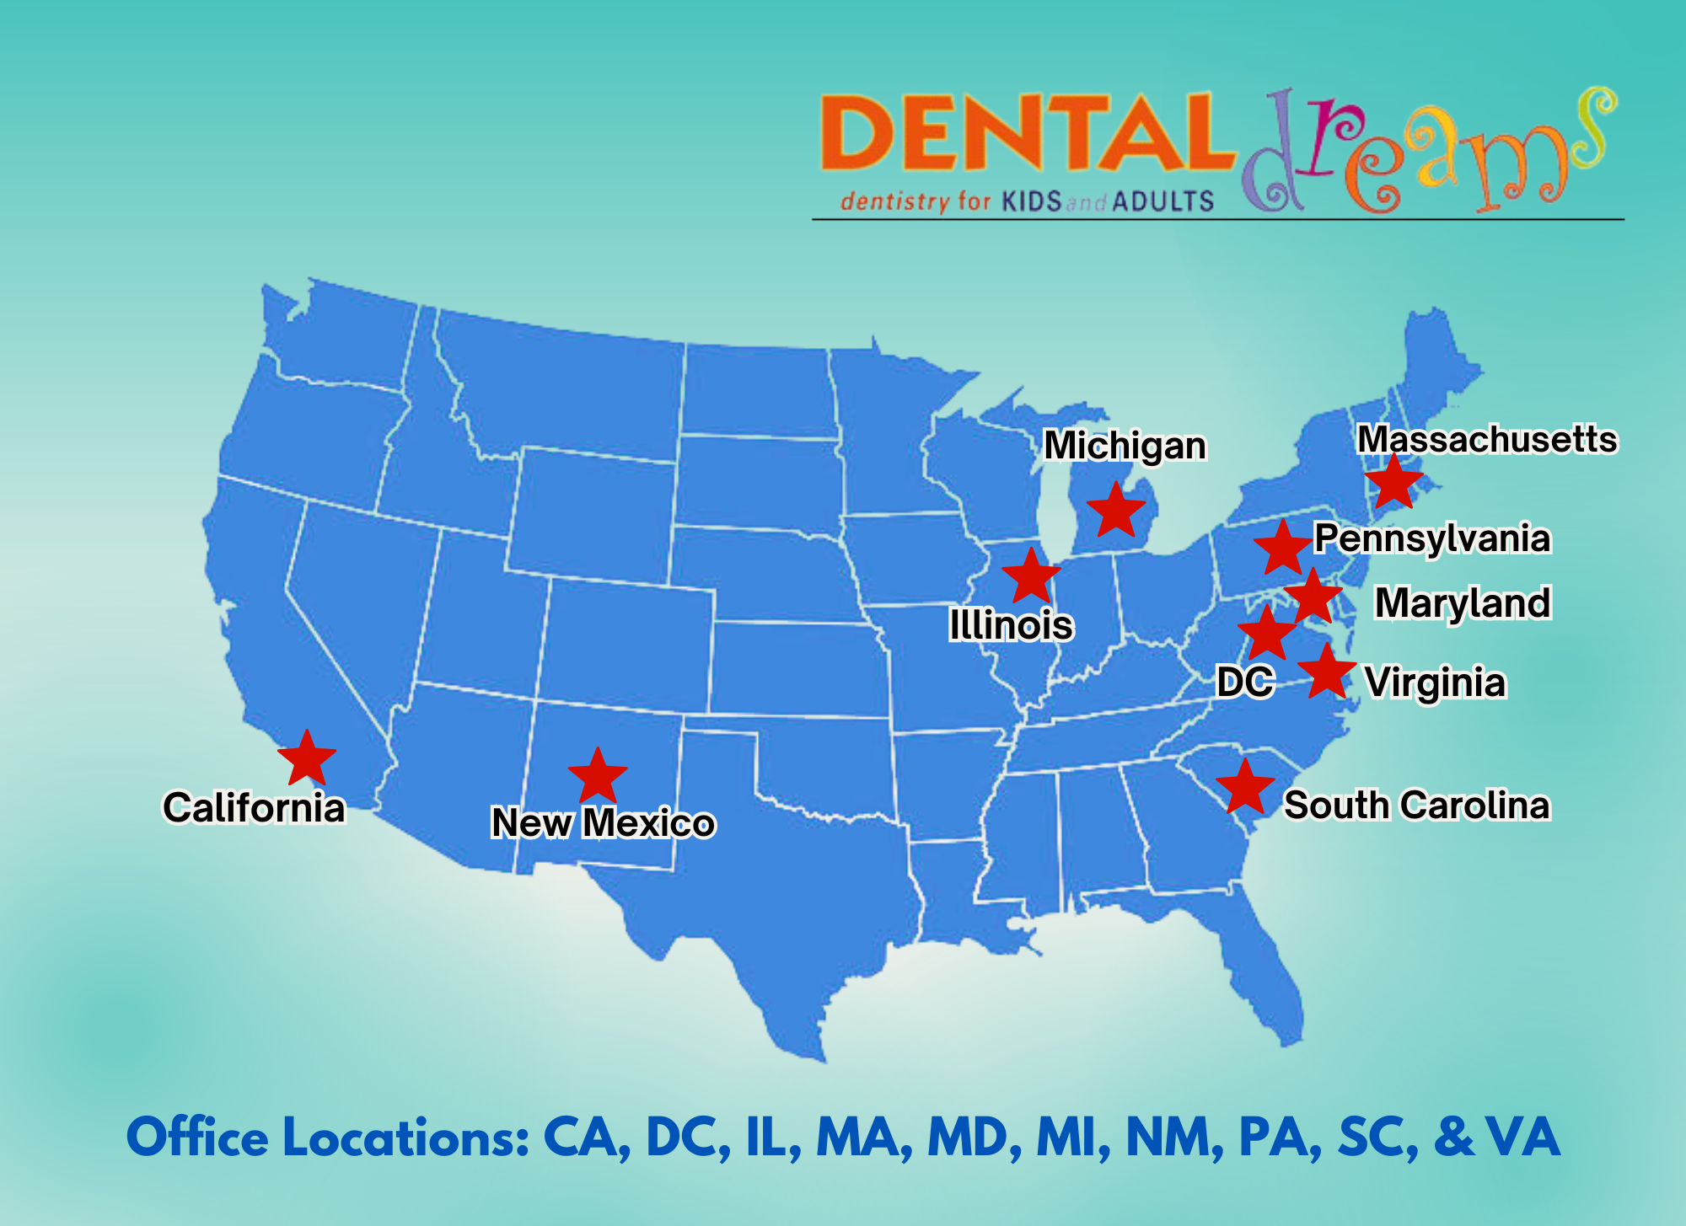

Slide 13
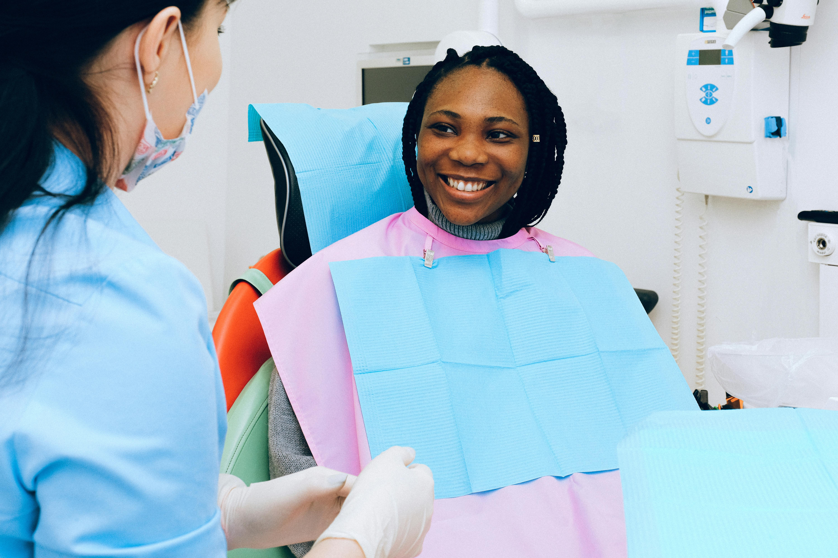
Diverse Patient Base
We’re proud to serve diverse, family-oriented communities across the U.S.
25% Pediatric | 75% Adult patients
We welcome all forms of dental insurance
    Medicaid
    PPO
    Self Pay
Notes:
With our widespread footprint, our goals remain the same.
Along with diverse payment, we see diverse ages of patients.
PPO, self pay, and Medicaid.
You’ll make a real impact—every single day.

Slide 14
What You’ll Do
Fillings
Crown & Bridge
Extractions
Dentures
Hygiene
Endodontic Procedures
Aligners
Full Mouth Restorations
Notes:
No specialists
Once you see a patient, we prioritize you being the provider for their whole family.
We see a very wide scope of services. Truly the bread and butter of general dentistry.
No specialists on site
No implant placement

Slide 15
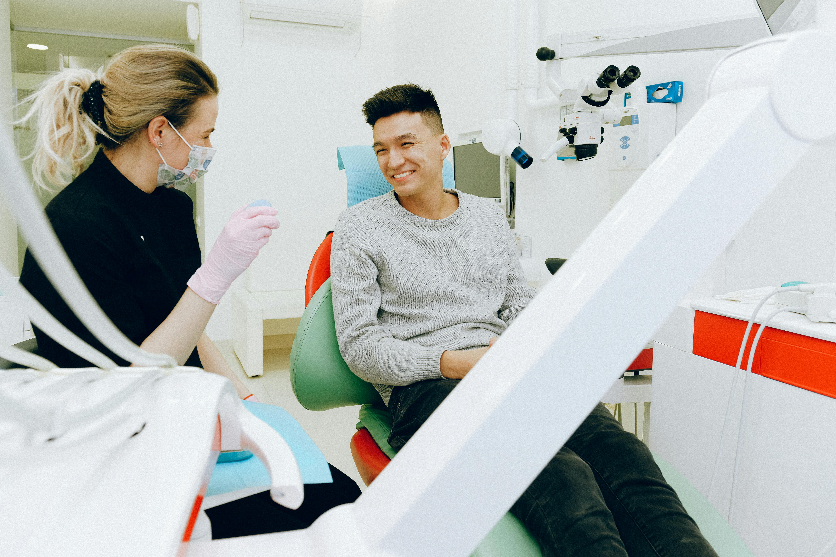
Mentorship that Matters
What tools and resources will you have available to grow your skills and confidence?
Layers of mentorship:
    Associate Dentists
    Clinic & Regional Managers
    Clinical Directors
    Endodontic Mentor
Notes:
Anything you do not have as much experience in, you will have ample support to learn on the job.
2-5 associates
Mentoring by top rated, experienced clinicians
We grow together—because your success is our success

Slide 16
Full Suite of Benefits
Health & Vision insurance
Dental coverage
Malpractice insurance
Free Continuing Education + $1,500 Reimbursement
Three weeks vacation
401 (k)
Balanced Schedule
          Monday-Friday 10AM-6PM
          1 Saturday/month
Notes:
Free dental coverage for associates and all immediate family members

Slide 17




Visa Sponsorship
H-1B
Permanent Residency
Multiple Lottery Opportunities
Legal Consultation
Notes:
Do we have any international dentists here today?
Legal Consultations & Lottery Support
Ideally sign your contract before February so we can enter the lottery before graduation.
Sign soon so we can file an h1b this winter while you’re in school and give you 2 shots at the lottery. Usually start green card 30 days after she starts working.

Slide 18
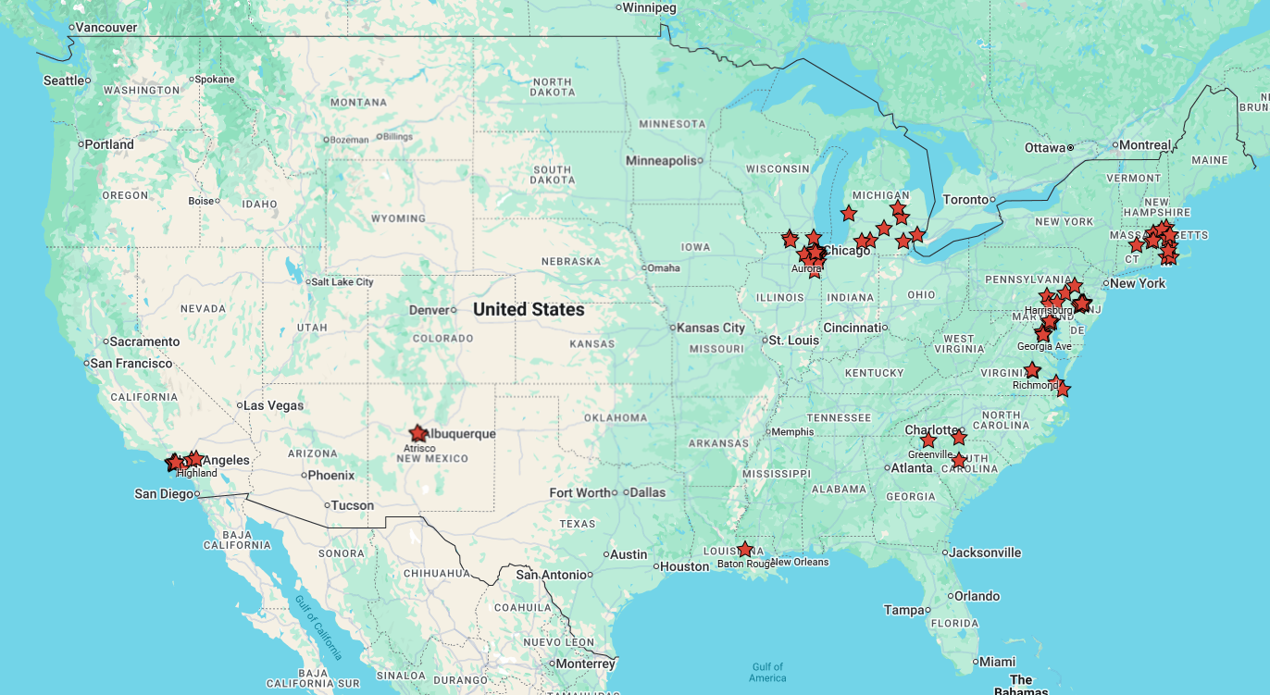
Notes:
We have 1 year contracts, so you have an amazing opportunity to try living in a new state and make a ton of money.
States with $50,000 Sign on Bonus: NM, LA, IL, MI, MA, PA, SC

Slide 19
The Application Process
1st
2nd
3rd
4th
5th
Phone Screen with Amadi
Meet with one of the owners
Opportunity for office visit with Regional Manager
Contract Negotiation
Your career begins!
Notes:
Typically we have D4s start signing around November/December so they have location priority
We make joining easy, transparent, and personalized.

Slide 20
Follow-Up Like a Pro
FOLLOW THROUGH:
Send a Thank You email
Return phone calls, messages, & emails quickly
Show your motivation and level of interest!
Notes:
Reaffirm after the interview that you think you are a good fit for the role

Slide 21
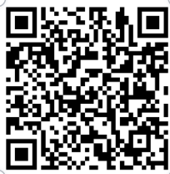
Thank you!
Amadi Forbes
Doctor Recruitment and Relations
KOS Services, LLC|Dental Dreams
Mobile: (312) 825-6141
Email: aforbes@kosservices.com
Schedule a call to
learn more!

